Slide 1
Removing barriers to overseas building products
Webinar will start shortly

Slide 2
Housekeeping:
You can ask questions at any time using the Q&A function.
We’ll also answer a few questions live at the end.

Slide 3
How did we get here?
April
2024
May -June
2024
Apr
2025
Sep
2024
Consultation on implementation
Select Committee process
Legislation introduced to parliament
Legislation passes
Changes announced for overseas building products

Slide 4
Speakers and pathways
Katie Symons
Principal Advisor Engineering, BPE
Building Product Specifications (BPS)
Incorporate more product standards in Building Code compliance pathways
Recognition of Overseas Certified Products
MBIE approval of product certificates issued by reputable overseas certification schemes and bodies
Amanda Macauley
Principal Advisor, SPI
Lisa Clephane
Technical Lead, BSDA
Minister Endorsed Standards & Standards Certification Schemes
Improved confidence using overseas standards from reputable organisations

Slide 5
Building Product Specifications
A new regulatory instrument

Slide 6
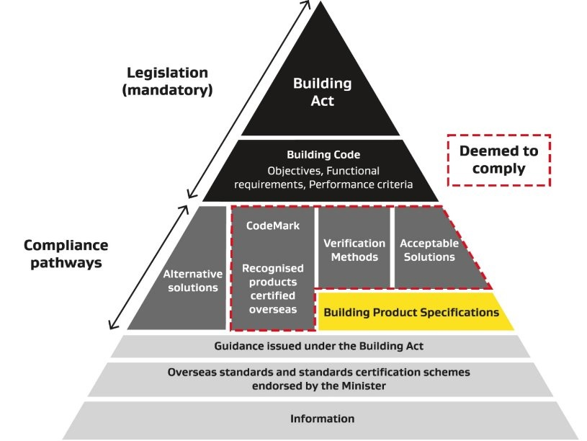
Building Product Specifications (BPS)
Product specifications and standards currently cited in compliance pathways will be cited in the Building Product Specifications instead
Additional overseas product standards cited only if assessed as requiring equivalent or better performance
When referenced by acceptable solutions and verification methods, content becomes deemed-to-comply

Slide 7
A streamlined update process
The Building Product Specifications is intended to:
provide more compliance options
NOT
change performance requirements
Therefore:
MBIE will consult on proposed material to incorporate by reference only
No options analysis and impact assessment required
Consultation periods will be shorter than previous Building Code consultations

Slide 8
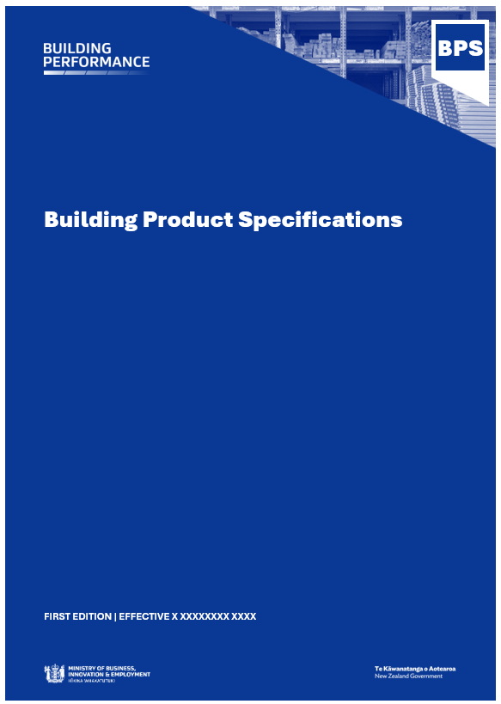
What does the BPS look like?
Aligned with how products are specified in building projects
Avoids product info spread across multiple AS & VM documents
Contents
Part 1: General
Part 2: Structure
Part 3: Enclosure
Part 4: Interior
Part 5: Finishes
Part 6: Services
Part 7: Fire characteristics

Slide 9
Standards in Building Code documents
Pre-BPS:
450+
Cited standards in the AS and VM documents
250+
Building product standards
140
Only option for demonstrating compliance
Post-BPS:
120+
Cited product standards in the BPS
90%
Either joint AS/NZS or overseas product standards
~50%
New or updated standard citations

Slide 10
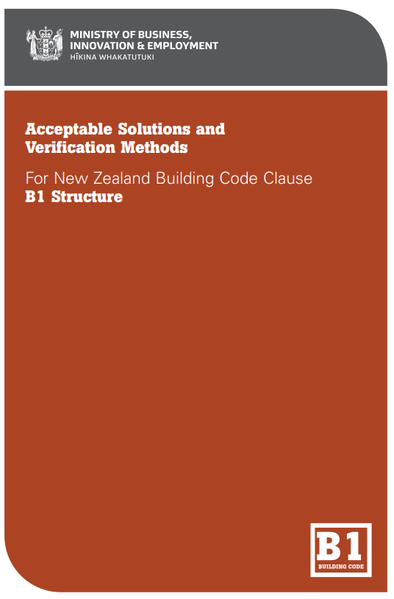
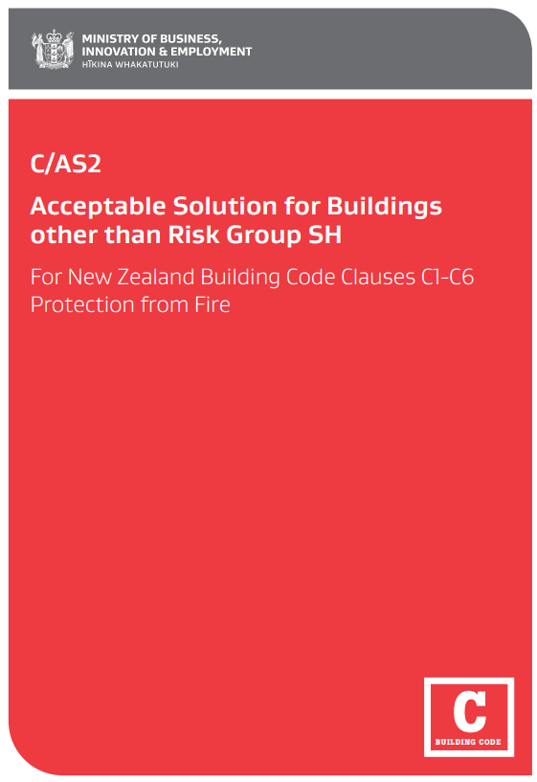
The BPS and AS/VMs
Both set requirements:
How the product must be specified
eg
testing
fabrication
physical properties
How the product must be used in building work

Slide 11
What is in the draft BPS first edition?
Specifications and standards for:
Concrete
Steel
Timber
Cladding
Windows
Plasterboard (bracing)
Insulation
HVAC
Fire characteristics of products
First edition is not comprehensive:
Does not cover all building products
Does not cover all aspects of product performance
Some product requirements remain in the AS&VMs
Additional requirements for products outside the Building Code, eg Health & Safety Regulations

Slide 12
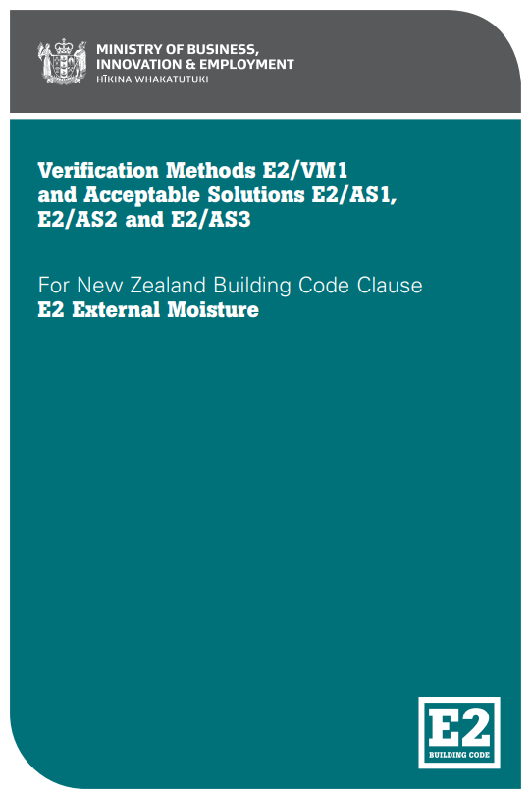
Compliance pathways via the BPS
Example: Fibre cement cladding products
Pre-BPS
Post-BPS
AS/NZS 2908.2:2000
ISO 8336:2017
BS EN 12467:2012
AS/NZS 2908.2:2000
Single product standard cited in E2/AS1 → deemed-to-comply
Multiple product standard options cited in the BPS
The BPS cited in E2/AS1 → deemed-to-comply

Slide 13
The BPS is not a deeming instrument
Cannot be used in isolation to demonstrate compliance with the Building Code
When an AS/VM references the BPS, content may contribute to Building Code compliance
Products specified must be used within the scope & limitations of the AS/VM

Slide 14
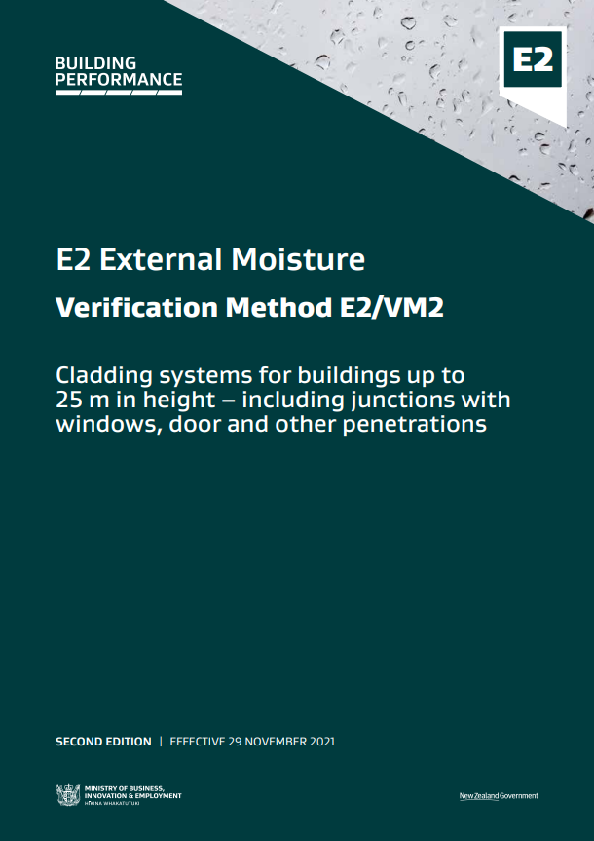
Updates to Building Code documents
Acceptable solutions and verification methods
Updated to:
reference the BPS
make format consistent
improve readability
improve digital capabilities

Slide 15
Next Steps
3 week consultation on draft BPS V1
3rd – 23rd June 2025
Publish BPS and updated AS/VMs
July 2025
Sector engagement to develop BPS V2
From August 2025….

Slide 16
Approved Products Certified Overseas
Recognising building products and methods certified overseas as deemed-to-comply

Slide 17
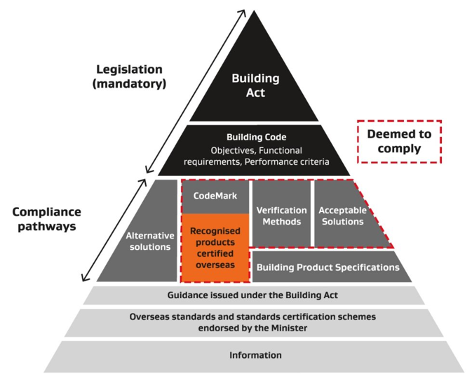
Approved Products Certified Overseas
Chief Executive of MBIE may recognise building products or methods certified overseas
Will be deemed to comply like CodeMark – BCAs must accept
Recognition notices will detail what New Zealand Building Code clauses apply and if there are any limitations on the recognition
Recognitions can be amended or revoked

Slide 19
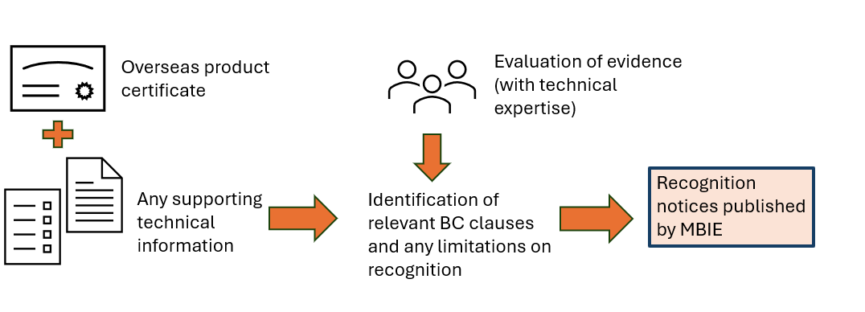
Evaluation process for products
Evidence of compliance with BC

Slide 20
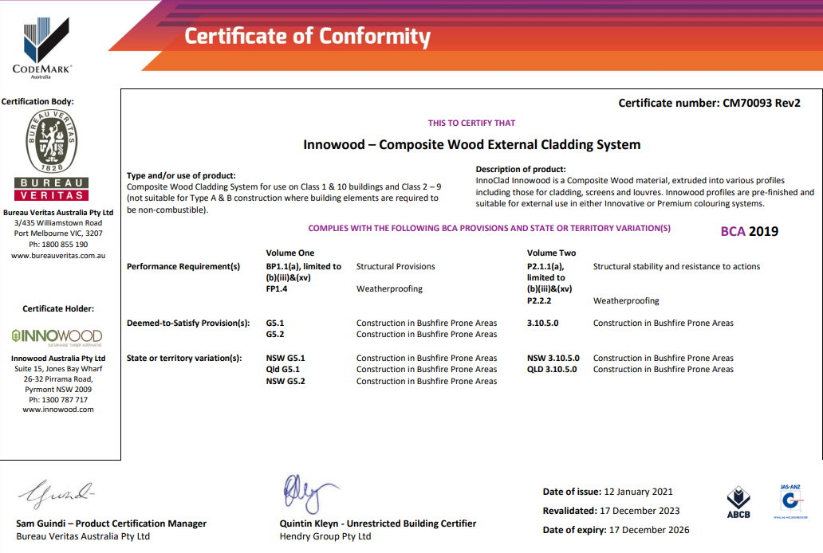
Evaluation example – CodeMark Oz
Technical expertise required to identify relevant BC Clauses
Recognition notice for product– complies/contributes to compliance with:
B1 Structure: B1.3.1, B1.3.2, B1.3.3(a, f, h, j), B1.3.4
B2 Durability: B2.3.1(b)
E2 External Moisture: E2.3.2, E2.3.5, E2.3.7,F2 Hazardous Building Materials:F2.3.1

Slide 21
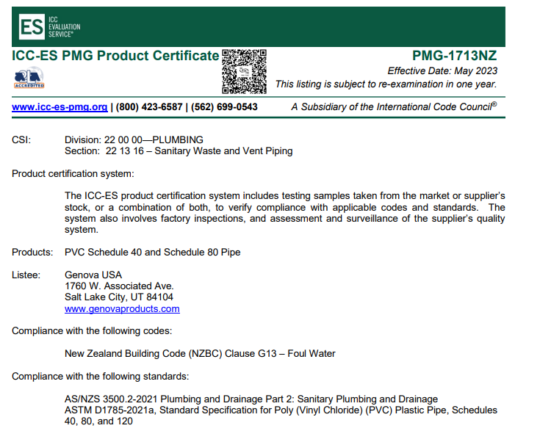
Evaluation example – ICC
Technical expertise required to identify relevant BC Clauses
Recognition notice for ICC-ESR notice
Complies with G13 (when used as intended)

Slide 22
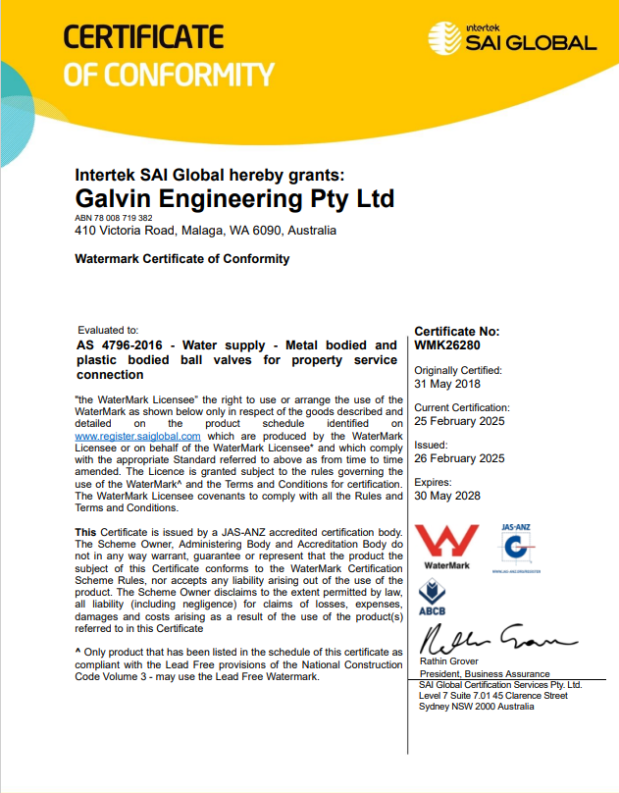
Evaluation example – WaterMark
Technical expertise required to identify relevant BC Clauses
Does product comply with AS/NZ 4020?
Recognition notice for WaterMark product
complies with G12 (when used as intended)

Slide 23
Evaluation criteria
No warnings or bans Sufficient info available for users
Product certs
Installation info
BPIR
Other technical info

Slide 24
Liability
Building Act 2004 (section 14G):
A product manufacturer/supplier must ensure product will comply with the relevant provisions of the Building Code, if installed in accordance with the technical data, specifications etc prescribed by the manufacturer.
Product supplier must comply with BPIR requirements.
Consumer Guarantees Act 1993:
Guarantees that building products are:
of acceptable quality
fit for purpose
match their description
supported by spare parts and repair facilities.

Slide 25
What’s next?
Regulations expected to commence by Sept 2025.​
First recognitions before the end of 2025.
Work underway on a possible application process for manufacturers/importers .​
Operational policy and more info coming soon.

Slide 26
Minister endorsed standards & standards certification schemes
Improving confidence in quality overseas products

Slide 27
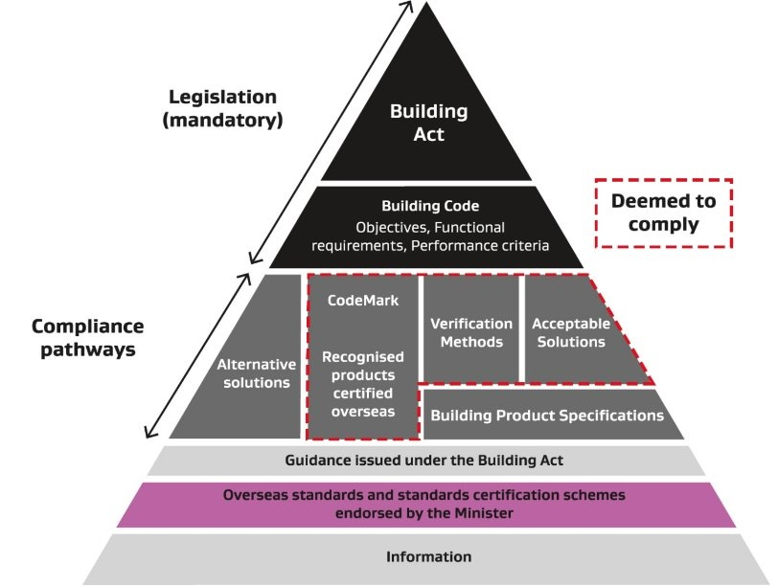
Minister Endorsed Standards
This initiative covers:
groups of standards issued by overseas standards organisations, and
standards certification schemes that a standards certification organisation administers or operates under.
It sits outside deemed-to-comply pathways.

Slide 28
How will it work?
Criteria set in Regulations Groups of overseas standards and standards certification bodies must meet specific evaluation criteria outlined in regulations.
Evaluation by MBIE MBIE will assess these groups using the criteria, with help from technical experts if needed.
Advice to the Minister MBIE will recommend to the Minister which groups meet the criteria and can be endorsed.
Publication of endorsement Endorsed groups will be published on MBIE’s Building Performance website and in the New Zealand Gazette.
Updates and revocations Endorsed groups can be amended or revoked using the same publication and Gazette process.

Slide 29
Next steps and examples
Regulations coming soon The regulations that define the Minister’s decision-making criteria are expected to come into force by September 2025.
Who could be evaluated? Examples of overseas standards organisations that may be considered:
ASTM International (American Society for Testing and Materials)
CEN (European Committee for Standardization)

Slide 30
Benefits
While this initiative doesn’t provide a “deemed to comply with the Building Code” pathway the benefits are:
It will indicate which overseas standards organisations are considered robust and trustworthy.
May be considered by Building Consent Authorities, for information.

Slide 31
Your questions
Is MBIE going to purchase standards for specifiers and BCAs to use for the BPS?
How do we know the product certificates MBIE has evaluated are suitable for NZ conditions?
How have the liability setting changed?
How will these changes affect products that currently use an alternative solution compliance pathway?

Slide 32
Thank you !
Building Product Specifications
Public Consultation – live now, open until Mon 23rd June
BPS and updated AS/VMs published July
Recognition of Overseas Product Certification
& Minister Endorsed Standards
Regulations under development – in force September 2025
First recognitions by end of 2025
EBOSS Specifiers (BCAs and LBPs) Survey – live now
EBOSS Product Suppliers Survey – live 11 June 2025
Building@mbie.govt.nz
www.building.govt.nz/overseasproducts

