Slide 1
Building Code Update 2025
Building Product Specifications and amended acceptable solutions and verification methods
Hosted by:
Katie Symons, Principal Advisor Engineering
Devin Glennie, Principal Advisor Building Code

Slide 2



Housekeeping
Recording will be available
Ask questions at any time using the Q&A function.
We’ll answer as many as we can live at the end.

Slide 3
Overseas building products
More information: www.building.govt.nz/overseasproducts
Endorsed overseas standards
Recognition of products certified overseas
The Building Product Specifications
Standards in acceptable solutions and verification methods:
450+
Cited standards in the
AS and VM documents
250+
Building product standards
140
Only option
for demonstrating compliance

Slide 4
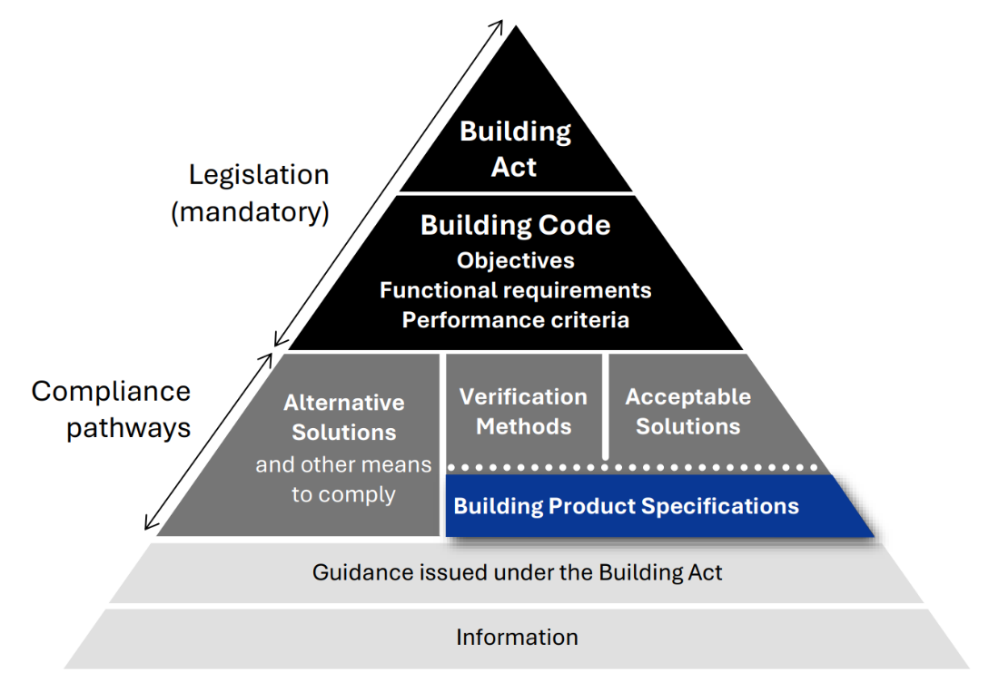
Building Product Specifications
Contains product specifications and standards previously cited in acceptable solutions and verification methods
Additional new product standards also cited, if assessed as requiring equivalent or better performance
When referenced by acceptable solutions and verification methods, BPS content becomes part of the compliance pathway
Products specified must be used within the scope and limitations of the AS/VM.
BPS cannot be used in isolation to demonstrate compliance with the Building Code.

Slide 5
Building Product Specifications – Consultation
120+
Proposed product standards the draft first edition
71
Submissions received during consultation
100+
Standards suggested for future editions
Changes from feedback:
Updated citations of steel and timber standards
Section numbering
90% AS/NZS or other non-NZS
>50% new or updated
Thank you!

Slide 6
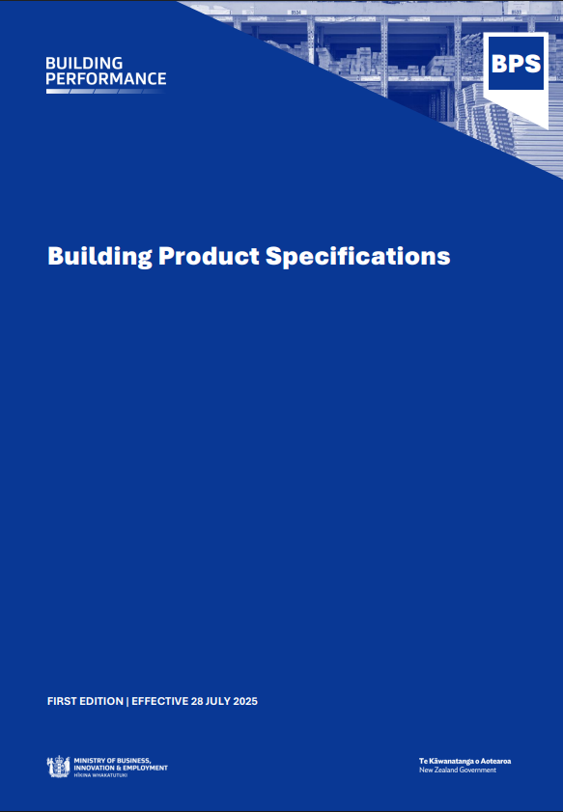
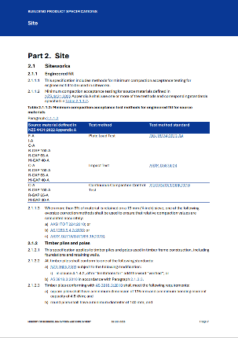
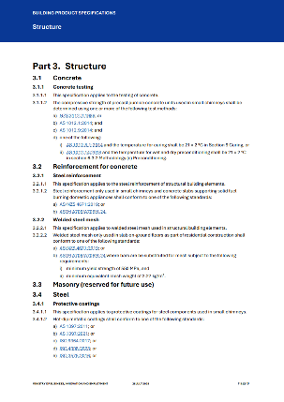
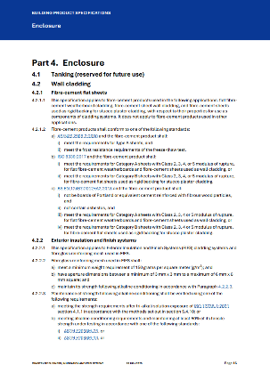
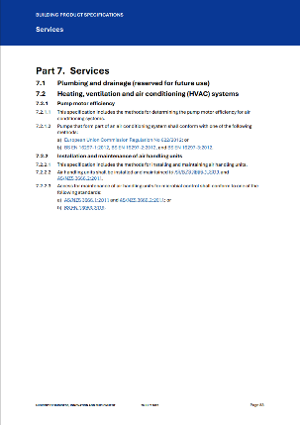
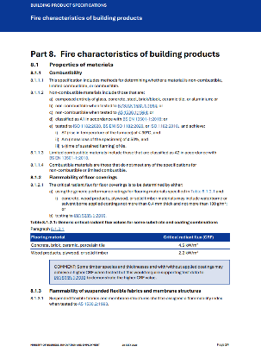
Organisation of the document
Organised by how products are specified in building projects
A single info source for suppliers and importers: how products can be specified to be used in code-compliant building work
Replaces product information spread across multiple AS and VM documents

Slide 7







Building Product Specifications: First edition
Specifications and standards for:
Concrete
Steel
Timber
Cladding
Windows
Plasterboard (bracing)
Insulation
HVAC
Fire characteristics of products
First edition is not comprehensive:
Does not cover all building products
Does not cover all aspects of product performance
Some product requirements remain in the
AS and VMs
There are additional requirements for products besides the Building Code
(for example, Health & Safety Regulations)
Suggestions of additional product standards to include in future editions are welcome

Slide 8
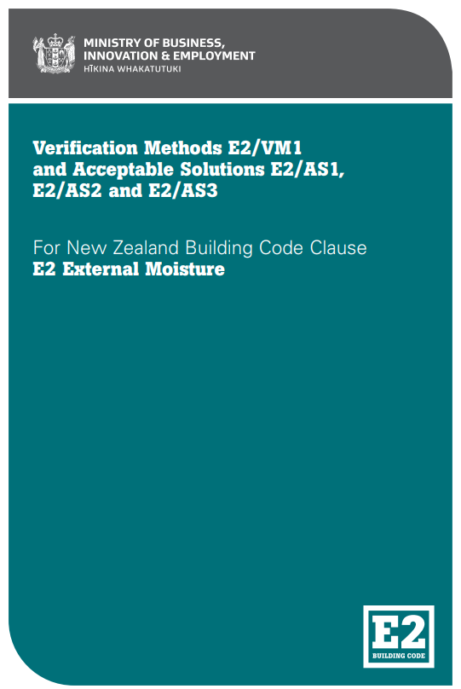
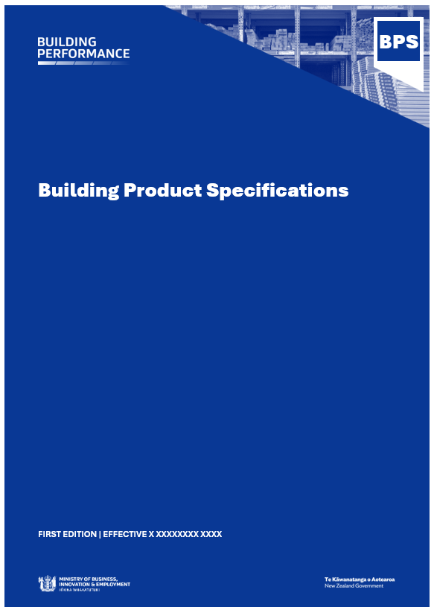
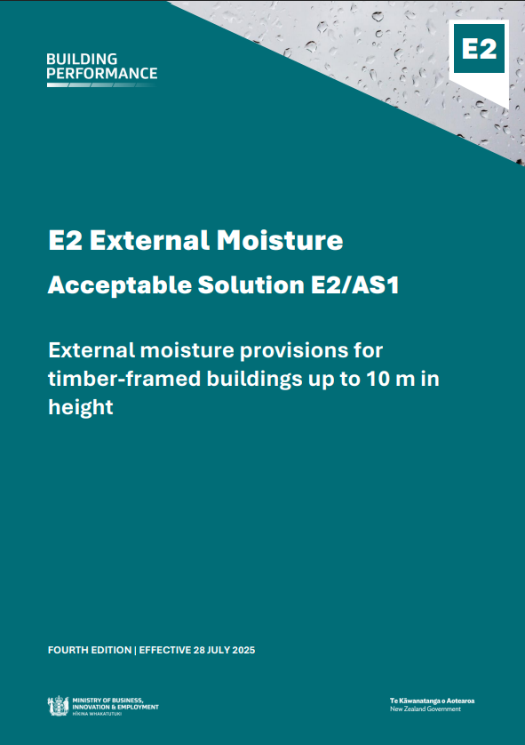

Compliance pathway via the Building Product Specifications
Example: Fibre cement cladding products in E2/AS1
E2/AS1 Third Edition
E2/AS1 Fourth Edition
AS/NZS 2908.2:2000
ISO 8336:2017
BS EN 12467:2012+A2:2018
AS/NZS 2908.2:2000
Single product standard cited in E2/AS1
Multiple product standard options cited in the BPS
Building Product Specifications are cited as part of E2/AS1

Slide 9
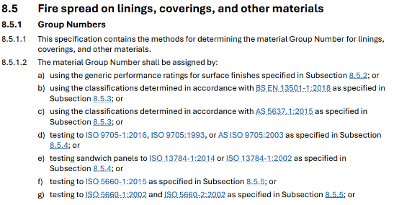
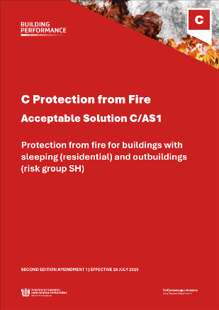
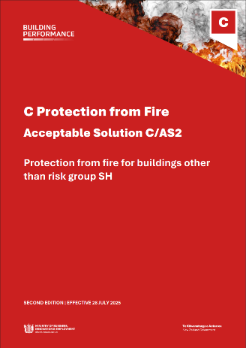
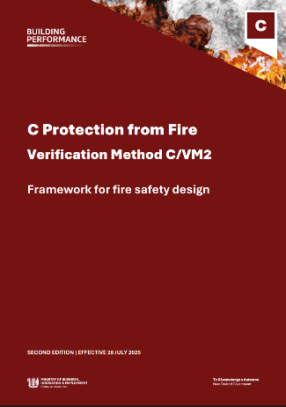

Compliance pathway via the Building Product Specifications
Example: Fire spread on linings in C/AS1, C/AS2, C/VM2
C/AS1, C/AS2, C/VM2 Second Edition
Options (a) to (i) cited in the BPS
Building Product Specifications section is cited in C/AS1, C/AS2, C/VM2

Slide 10
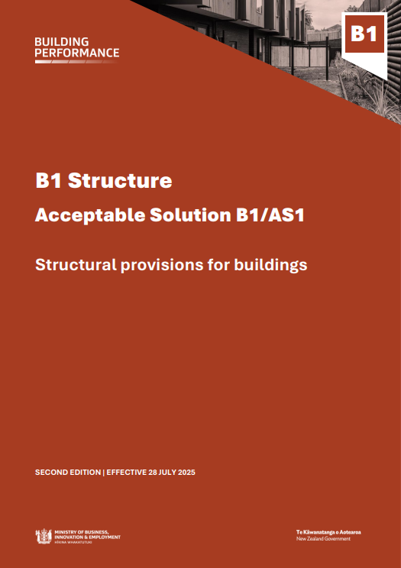
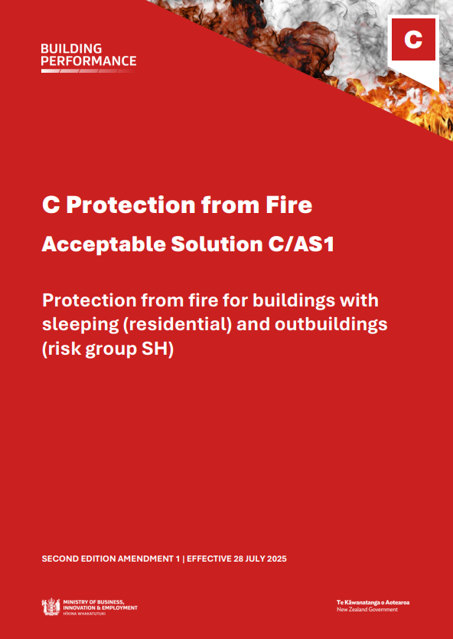
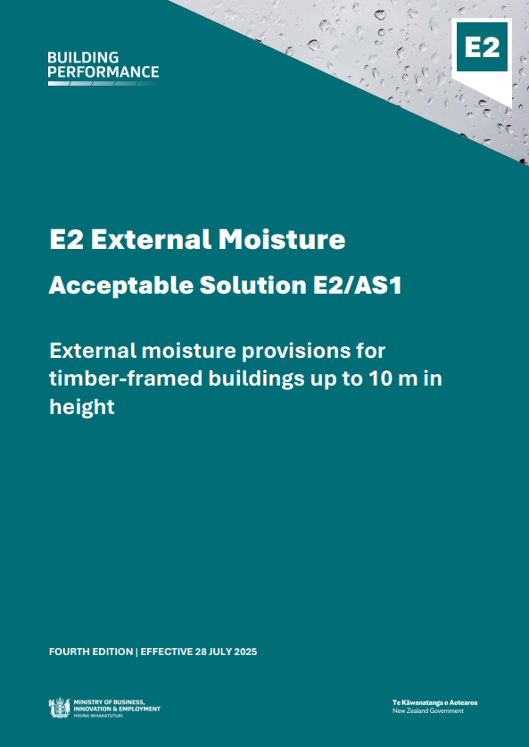
Building Product Specifications and existing compliance pathways
How the product must be specified
For example:
Testing
Fabrication
Physical properties
How the product must be used in building work

Slide 11
Acceptable solutions and verification methods
Devin Glennie, Principal Advisor Building Code

Slide 12
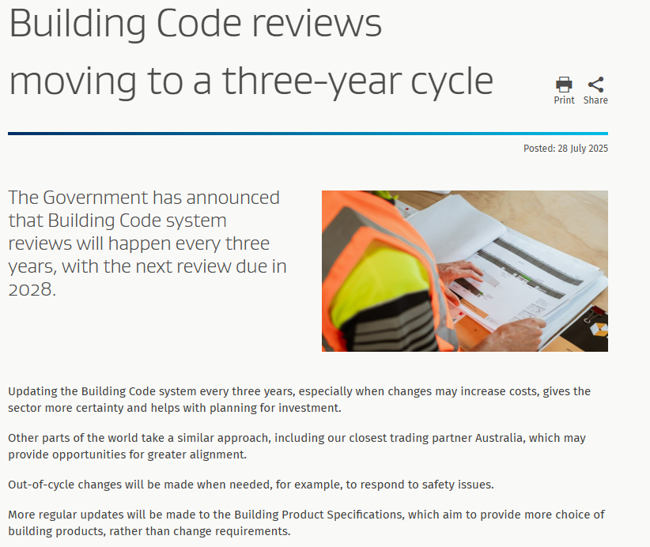

Slide 13
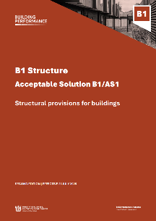
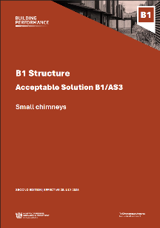
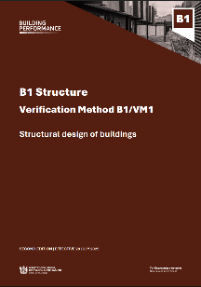
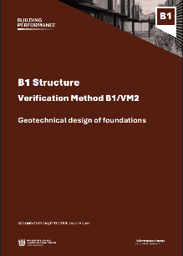
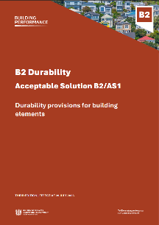
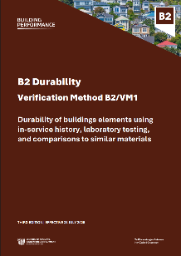


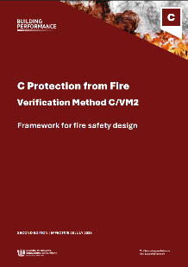
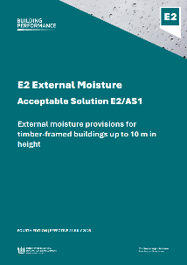
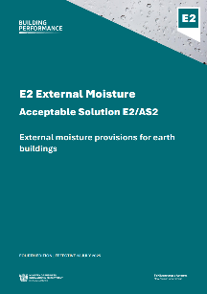
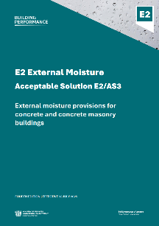
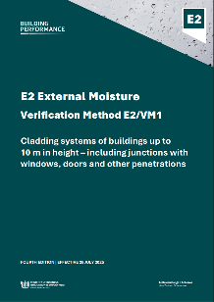
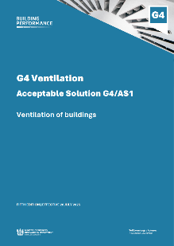
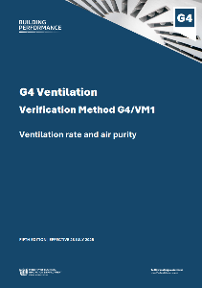
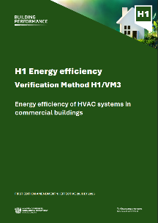
16 amended acceptable solutions and verification methods
Previous versions of the acceptable solutions and verification methods can continue to be used for
12 months until 31 July 2026.

Slide 14



Acceptable solutions and verification methods
New layout
Building Product Specifications
Minor amendments that do not affect the level of performance
www.building.govt.nz/bcu25

Slide 15
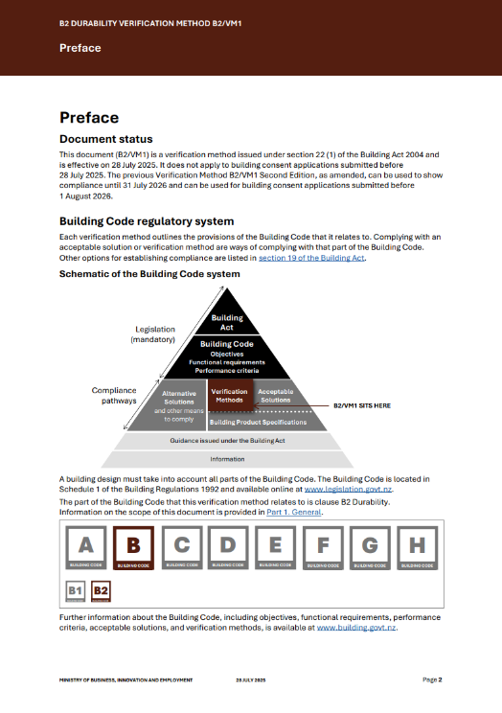
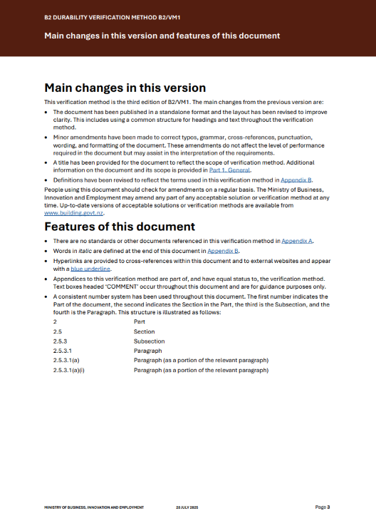
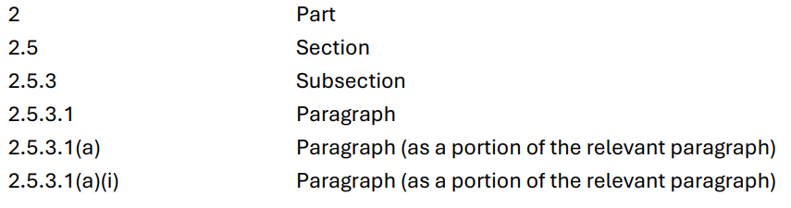
New document layout
Front of document
Example of heading structure:

Slide 16
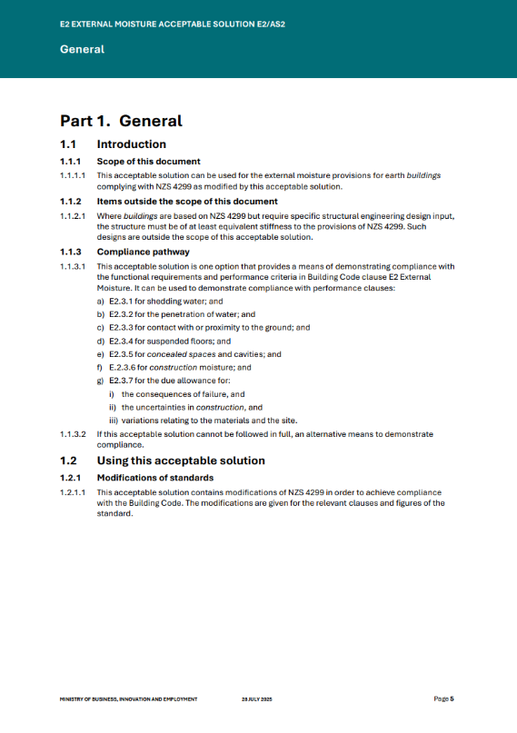
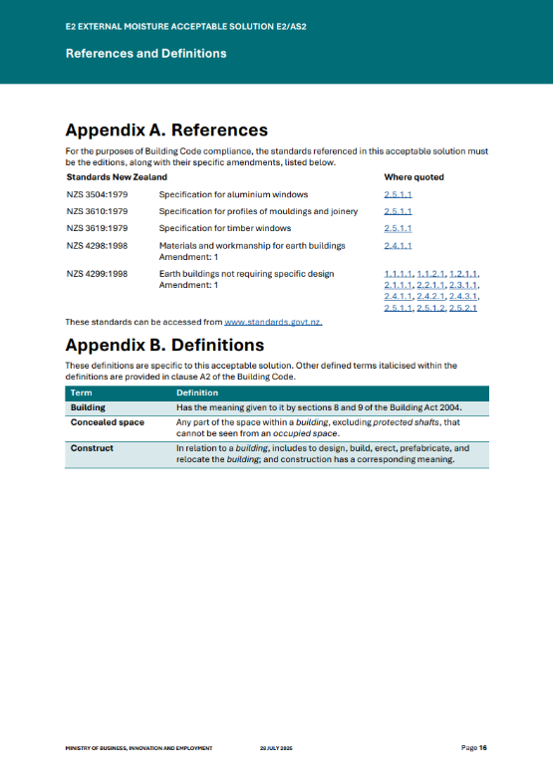
New document layout
Introduction
Appendices at the end
Part 1. General
1.1 Introduction
1.1.1 Scope of this document
1.1.2 Items outside the scope of this document
1.1.3 Compliance pathway

Slide 17




Republished without references to the BPS
B2/VM1
E2/AS2
E2/AS3
G4/VM1

Slide 18

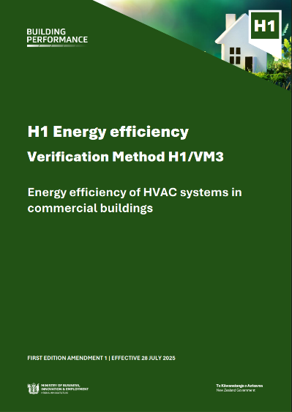
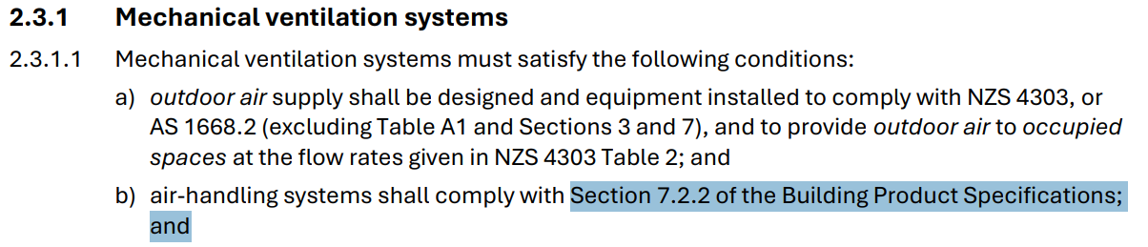
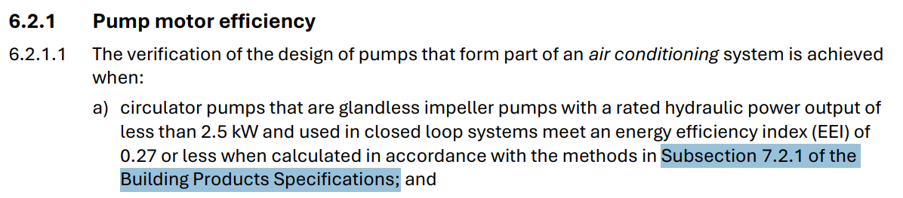
HVAC systems
G4/AS1
H1/VM3
Both documents reference the Building Product Specifications for equipment in HVAC systems
G4/AS1
H1/VM3

Slide 19
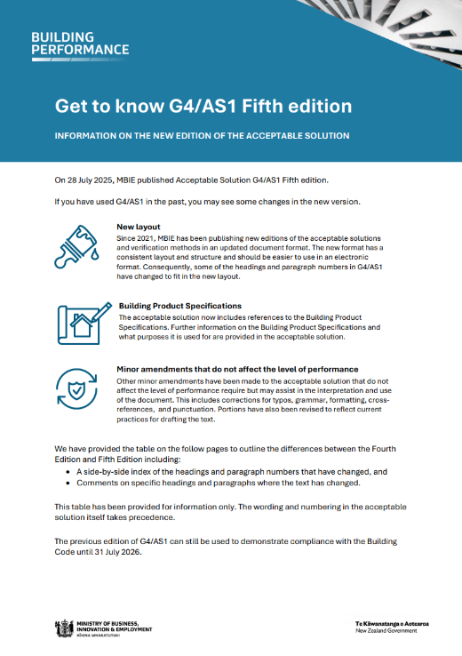
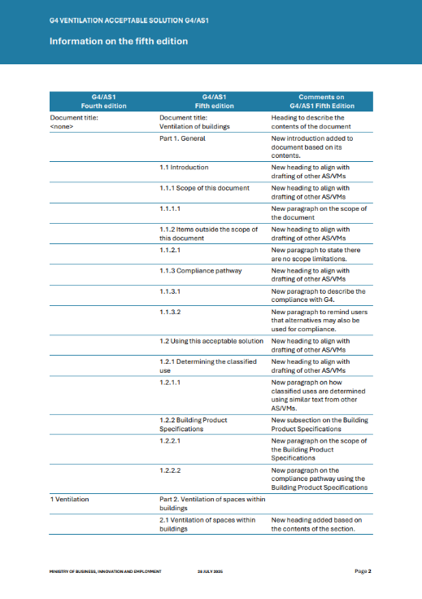
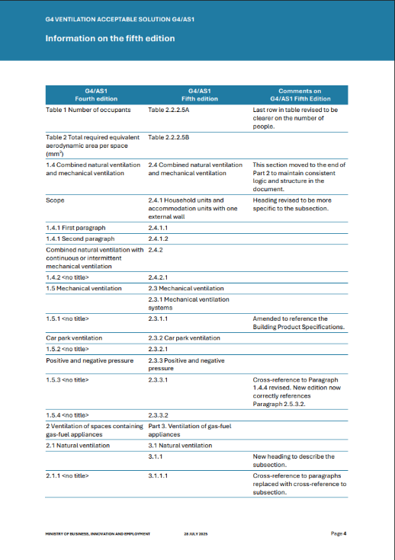
Information on G4/AS1 Fifth Edition
www.building.govt.nz/bcu25

Slide 20
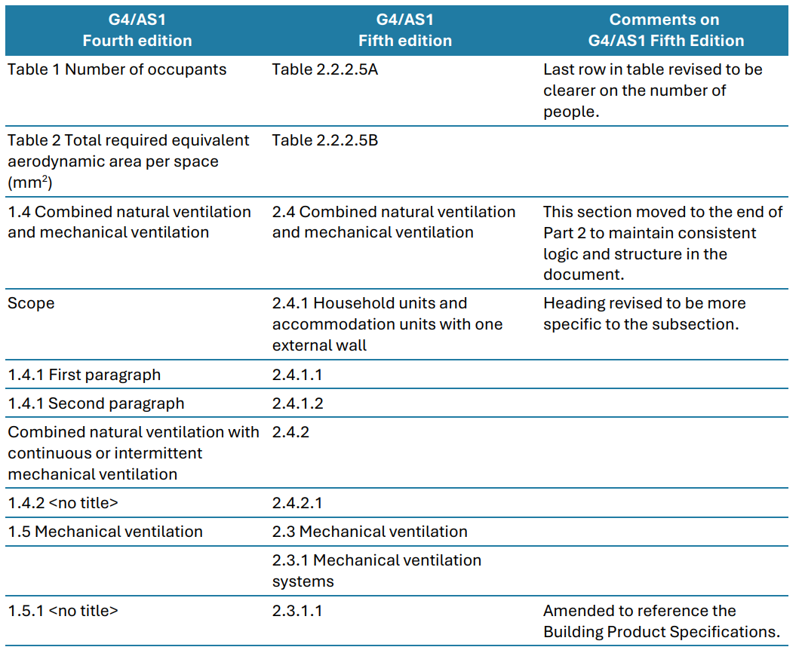
Information on G4/AS1 Fifth Edition

Slide 21
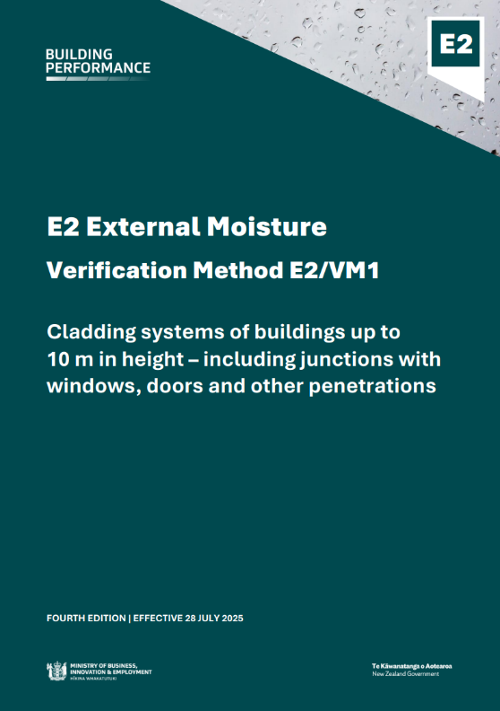
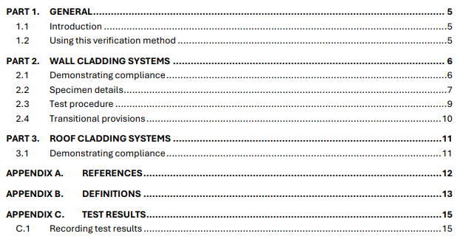
E2/VM1 Fourth Edition

Slide 22

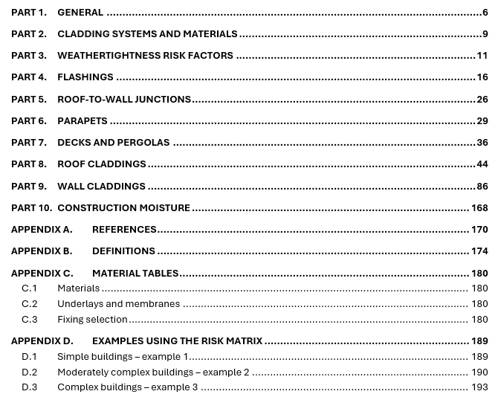
E2/AS1 Fourth Edition

Slide 23
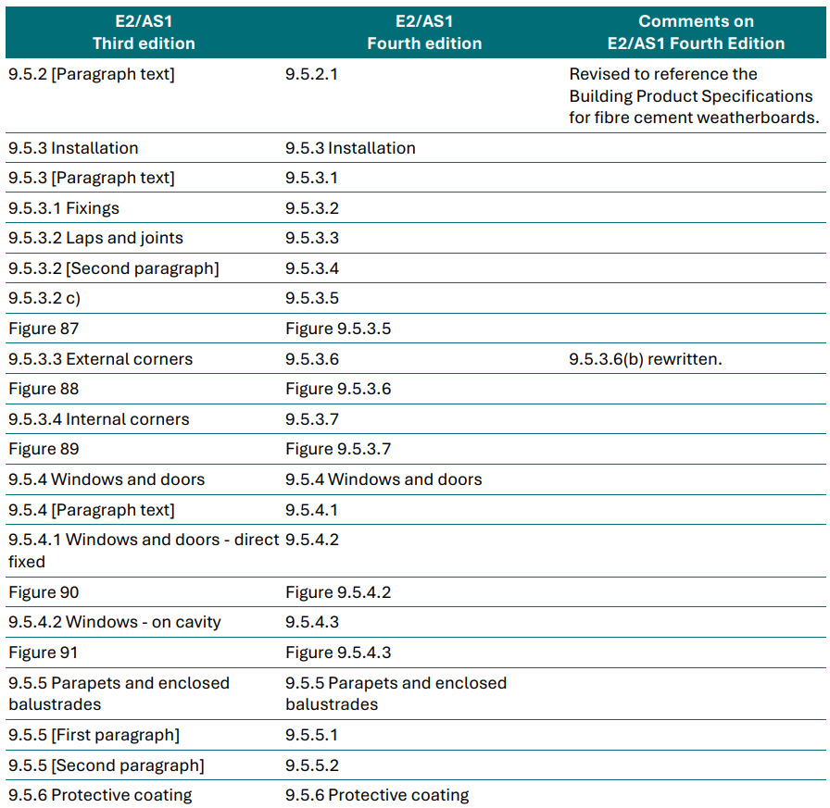
E2/AS1 Fourth Edition
Other minor changes not affecting the level of performance
Standardised headings and introductions to sections
Typos and cross-references updated throughout the document
Figures and tables renumbered to follow the paragraphs they are most associated with
Paragraphs redrafted to use more consistent wording throughout the document.

Slide 24
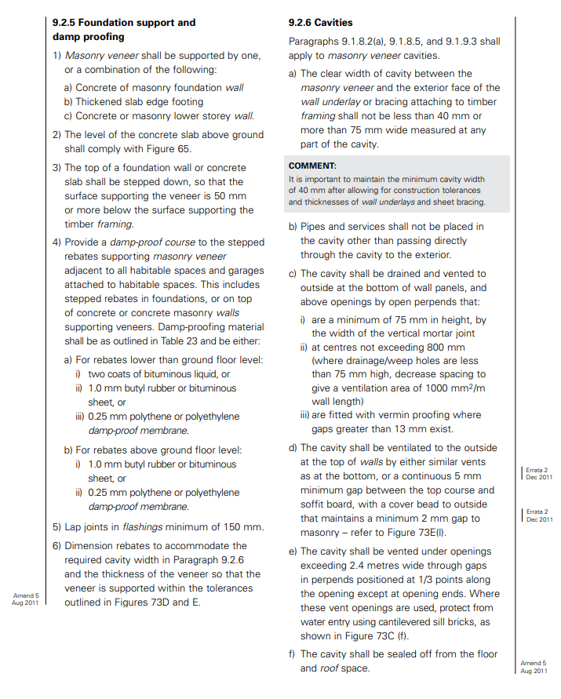
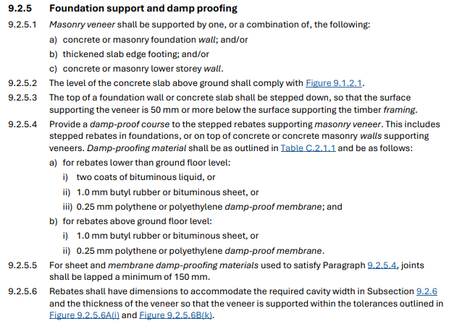

E2/AS1 Comparison
E2/AS1 Third Edition
E2/AS1 Fourth Edition

Slide 25


B2/AS1 Third Edition

Slide 26

B2/AS1 Third Edition – Comparison of the timber section

Slide 27

B2/AS1 Third Edition – BPS reference
Subsection 3.5.1 Durability – 50 years
Subsection 3.5.2 Durability – 15 years
Subsections 3.5.1 and 3.5.2

Slide 28



C/AS1, C/AS2, C/VM2
All references to fire testing standards relocated to the Building Product Specifications
C/AS1 already published in new format
C/AS2 and C/VM2 revised to the new document format. Headings and layout simplified
Tables simplified
C/VM2 design scenarios revised where the Building Product Specifications now contain the requirements

Slide 29

C/AS2 Second edition – Examples

Slide 30
C/AS2 Comparison – Part 3
C/AS2 First Edition
Part 3. Means of escape
3.1 General principles
3.2 Number of escape routes
3.3 Height and width of escape routes
3.4 Length of escape routes
3.5 Escape from basements
3.6 Open paths
3.7 Special cases of open paths
3.8 Dead ends
3.9 Exitways
3.10 Control of exitway activities
3.11 External escape routes
3.12 Final exits
3.13 Single escape routes
3.14 Special conditions
3.15 Doors subdividing escape routes
3.16 Signs
C/AS2 Second Edition
Part 3. Means of escape
3.1 General principles
3.2 Height and width of escape routes
3.3 Length of escape routes
3.4 Open paths
3.5 Exitways
3.6 External escape routes
3.7 Final exits
3.8 Single escape routes
3.9 Doors subdividing escape routes

Slide 31

C/AS2 Second edition – Table 2.2.1.1 fixed

Slide 32


C/VM2 Comparison – Design scenario IS
C/VM2 First Edition
C/VM2 Second Edition

Slide 33
Building Code fire safety review
In 2024, MBIE consulted on issues in the fire safety provisions in the Building Code.
There was broad support for the issues identified in the review.
On 8 August 2025, the Government announced plans change the fire safety clauses with proposed Building Code changes for Cabinet to consider early next year.

Slide 34




B1/AS1, B1/AS3, B1/VM1, B1/VM2 Second Edition
B1/AS1 Structural provisions for buildings
B1/AS3 Small chimneys
B1/VM1 Structural design of buildings
B1/VM2 Geotechnical design of foundations
B1/AS1 and B1/VM1 rewritten and re-organised along three main areas:
  standards for primary structure
  building elements
  sitework

Slide 35


B1/VM1 Second Edition

Slide 36

B1/VM1 Second Edition – Structural design actions

Slide 37


B1/AS1 Second Edition

Slide 38





B1/AS1 Comparison – NZS 3604
B1/AS1 First Edition
B1/AS1 Second Edition
…
…

Slide 39


B1/VM2 Second edition
Previous known as B1/VM4

Slide 40



B1/VM2 Comparison – Equations
B1/VM4 First Edition
B1/VM2 Second Edition

Slide 41


B1/VM2 Comparison – Equations for pile foundations

Slide 42
Summary

Slide 43
Summary
Building Product Specifications
  Make it easier to use overseas building products when complying with acceptable solutions and verification methods
  Provides more compliance options and doesn’t change minimum requirements
  Can’t be used on it’s own to demonstrate compliance, only when cited in AS and VMs
  Feedback welcome on product standards to cite in future editions of the BPS
Acceptable solutions and verification methods
  16 AS and VM documents have been updated to cite the BPS
  Documents look different but don’t require you to do anything different
  Updated editions have improved and consistent formats
  Information sheets show changes between old and new (www.building.govt.nz/bcu25)
  1 year transition period and previous documents can be used until July 2026

Slide 44
Questions?
More information:
www.building.govt.nz/bcu25
www.building.govt.nz/building-code-compliance/building-product-specifications
www.building.govt.nz/overseasproducts
learning.building.govt.nz (search “product”)
Contact us: building@mbie.govt.nz

